Slide 1
Introduction to TensorFlow 2.x
Week 9
Ph.D. Junetae, Kim
Assistant professor

Slide 2
Contents
How to define model structures
Sequential API
Functional API
Subclassing API
Exercise

Slide 3
How to define model structures
Goals
Learn how to design model structures using TF 2.x
Exercise : Prediction of survival of patients with lung cancer surgery.

Slide 4
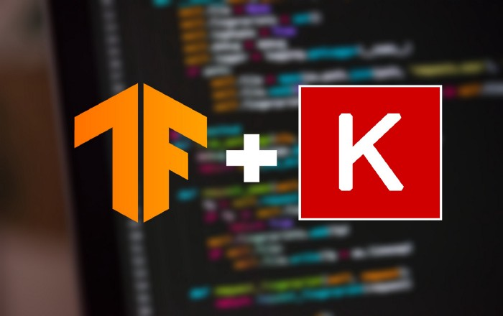
How to design model structures using TF 2.x
TensorFlow
Keras

Slide 5
How to design model structures using TF 2.x
TensorFlow
Keras
It’s a Deep Learning Library and along with that is provides a large set of tools for numerical computation, and large-scale Machine Learning. It also provide TensorBoard for visualization of model, TensorFlow Extended (TFX) to productionize TensorFlow projects, and much more.
Keras is a high-level Deep Learning API(Application Programming Interface) that allows us to easily build, train, evaluate, and execute all sorts of neural networks. What is does is abstract away the implementation of various Deep Learning libraries like TensorFlow, Microsoft Cognitive Toolkit(CNTK), and Theano.

Slide 6
How to define model structures
Example setting: lung cancer patient survival dataset
Model output: binary classification
Model setting: MLP(multilayer perceptron)
407obs with 17 features
1 = alive
0 = dead
Input layer
Hidden layers
Output layer

Slide 7
How to define model structures
Example setting: lung cancer patient survival dataset
Model output: binary classification
Model setting: MLP(multilayer perceptron)
Weight matrix
Weight matrix
Weight matrix

Slide 8
How to define model structures
Example setting: lung cancer patient survival dataset
Model output: binary classification
Model setting: MLP(multilayer perceptron)
Features
Obs.
Data (407, 17)
W.M.1 (17, 10)
Bias.1 (1, 10)
H.L.1 (407, 10)

Slide 9
How to define model structures
Example setting: lung cancer patient survival dataset
Model output: binary classification
Model setting: MLP(multilayer perceptron)
H.L.1 (407, 10)
W.M.2 (10, 5)
Bias.2 (1, 5)
H.L.2 (407, 5)

Slide 10
How to define model structures
Example setting: lung cancer patient survival dataset
Model output: binary classification
Model setting: MLP(multilayer perceptron)
H.L.1 (407, 5)
W.M.2 (5, 1)
Bias.3 (1, 1)
Out (407, 1)

Slide 11
How to define model structures
Example setting: lung cancer patient survival dataset
Model output: binary classification
Model setting: MLP(multilayer perceptron)
Out (407, 1)
Out (407, 1)
Sigmoid Out (407, 1)
Sigmoid function

Slide 12
How to define model structures
Three ways to design model structures
Sequential API: Simplest way but not recommended.
Functional API: Mostly preferred way.
Subclassing API: Used when grounds of layers should be customized.

Slide 13
How to define model structures
Sequential API:
This approach is employed for very simple use cases or baseline models.
It stacks a linear stack of layers.
https://colab.research.google.com/github/JunetaeKim/DeepLearningClass/blob/main/Week9/Sequential%20API.ipynb

Slide 14
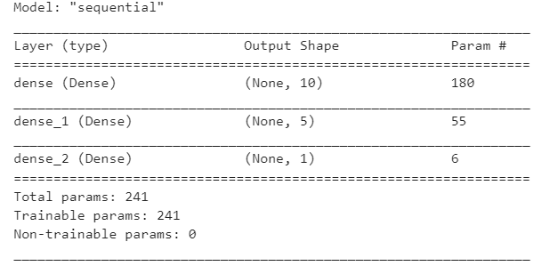
How to define model structures
Interpretation of model summary

Slide 15
How to define model structures
Interpretation of model summary
Why is the size of 1st dimension of layers ‘None’??

Slide 16
How to define model structures
Interpretation of model summary
Understanding batch learning
Features
Let’s suppose we have a large dataset with 500,000 observations
Obs.
The workstation's RAM memory and graphics card memory may not be sufficient for deep learning training using this large amount of data.
Data (500,000 X 17)

Slide 17
How to define model structures
Interpretation of model summary
Understanding batch learning
Features
Therefore, we can train the model by splitting the data, which is called batch learning.
Iteration #1
Obs.
Iteration #2
Data (500,000 X 17)

Slide 18
How to define model structures
Interpretation of model summary
What are the numbers in the 2nd dimension of layers?

Slide 19
How to define model structures
Features
Obs.
Data (407, 17)
W.M.1 (17, 10)
Bias.1 (1, 10)
H.L.1 (407, 10)
It is a hyperparameter given by developers

Slide 20
How to define model structures
Interpretation of model summary
How is the parameter size determined?

Slide 21
How to define model structures
Trainable weight matrices
Features
Obs.
Data (407, 17)
W.M.1 (17, 10)
Bias.1 (1, 10)
H.L.1 (407, 10)
(17 x 10) + (1x10) = 180

Slide 22
How to define model structures
Functional API:
This approach is employed for building nonsequential or complicated models in which various inputs, hidden layers, and outputs are connected out of sequence.
Input
Hidden1

Slide 23
How to define model structures
Functional API:
This approach is employed for building nonsequential or complicated models in which various inputs, hidden layers, and outputs are connected out of sequence.
Input
Hidden2
Concatenation
Input
Hidden1

Slide 24
How to define model structures
Functional API:
Layer concatenation
Features
Data (407, 17)
WM1 (17, 10)
Bias1 (1, 10)
HL1 (407, 10)
Concat(Data, HL1, axis=1) = ?

Slide 25
How to define model structures
Functional API:
Concat(Data, HL1, axis=1) = HL2
Features
HL1
HL2 (407, 27)

Slide 26
How to define model structures
Functional API:
Sequential APIs do not allow layer-concatenation as shown below.
Features
HL1
HL2 (407, 27)

Slide 27
How to define model structures
Functional API:
This approach is employed for building nonsequential or complicated models in which various inputs, hidden layers, and outputs are connected out of sequence.
Input
Hidden2
Concatenation
Input
Hidden1

Slide 28
How to define model structures
Functional API:
This approach is employed for building nonsequential or complicated models in which various inputs, hidden layers, and outputs are connected out of sequence.
Input
Hidden2
Hidden3
Out
Concatenation
Input
Hidden1

Slide 29
How to define model structures
Functional API:
This approach is employed for building nonsequential or complicated models in which various inputs, hidden layers, and outputs are connected out of sequence.
https://colab.research.google.com/github/JunetaeKim/DeepLearningClass/blob/main/Week9/Functional%20API.ipynb

Slide 30
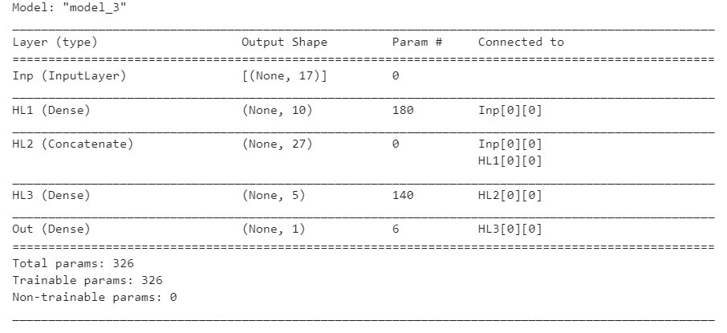
How to define model structures
Interpretation of model summary
Layer_name[x][y] corresponds to the node index (i.e. node_indices) and tensor index (i.e. tensor_indices) of the the input tensors, respectively.
When the output of a layer is used by another layer, a new node is created

Slide 31
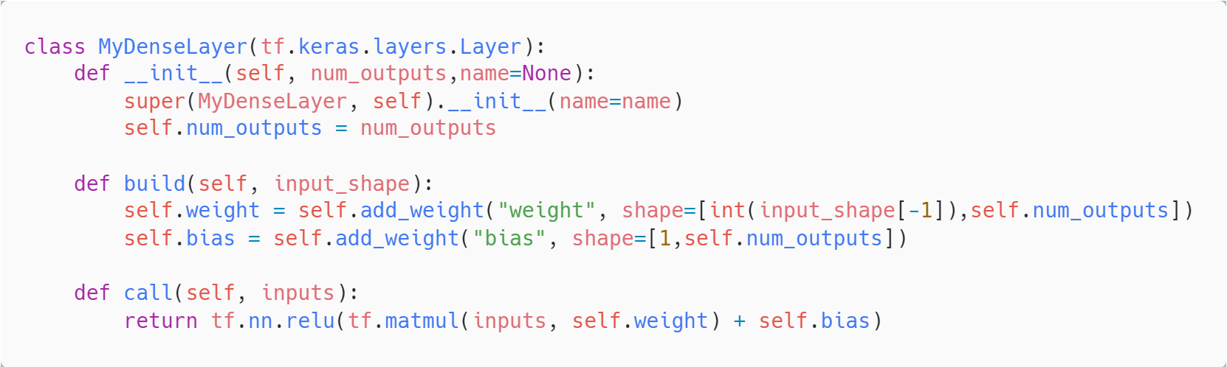
How to define model structures
Subclassing API:
Sometimes you need to develop customized layers for sophisticated models.
Keras allows to create our own customized layer. Once a new layer is created, it can be used in any model without any restriction.

Slide 32
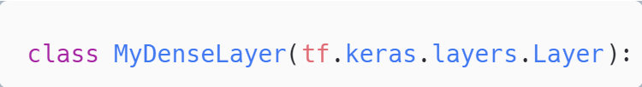
How to define model structures
Steps to build models using Subclassing API:
Step 1: Define a layer class
Class name
Inheritance
Inheritance: Inheritance allows us to define a class that inherits all the methods and properties from another class(existent class in TF)

Slide 33
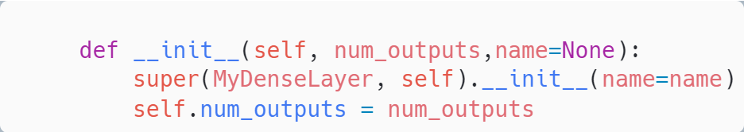
How to define model structures
Steps to build models using Subclassing API:
Step 2: Initialize the layer class
Line 2 calls the super(tf.keras.layers) layer’s existent methods.
Line 3 sets the output dimension.

Slide 34
How to define model structures
Steps to build models using Subclassing API:
Step 2: Initialize the layer class
Trainable weight matrices
Features
Obs.
Data (407, 17)
W.M.1 (17, 10)
Bias.1 (1, 10)
H.L.1 (407, 10)
Line 3 sets the output dimension as 10

Slide 35
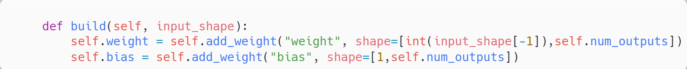
How to define model structures
Steps to build models using Subclassing API:
Step 3: Implement build method
build is the main method to build the layer properly. Generally, it initializes trainable weight matrices
Line 1 input_shape: shape of the input data is referred by input_shape.

Slide 36
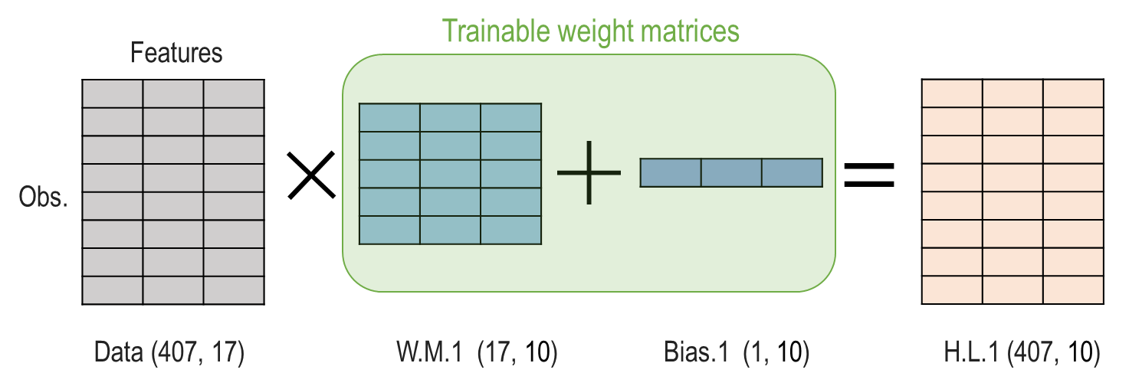
How to define model structures
Steps to build models using Subclassing API:
Line 1 input_shape: shape of the input data is referred by input_shape.
input_shape
Input
Operation
Output

Slide 37
How to define model structures
Steps to build models using Subclassing API:
Step 3: Implement build method
build is the main method to build the layer properly. Generally, it initializes trainable weight matrices
Line 2 to 3: generate a weight matrix and a bias corresponding to input shap

Slide 38
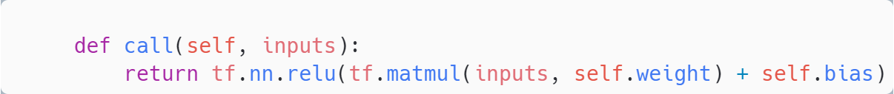
How to define model structures
Steps to build models using Subclassing API:
Step 4: Implement call method
call method allows matrix operations.
Line 1 defines the call method with one argument, input_data, the input data from the previous layer.
Line 2 return the result of the matrix operation.

Slide 39
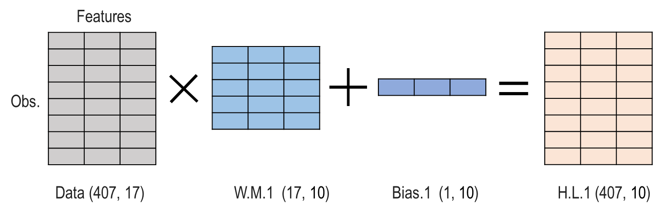
How to define model structures
Steps to build models using Subclassing API:
Line 2 return the result of the matrix operation.

Slide 40

How to define model structures
Steps to build models using Subclassing API:
Step 5: Use the customized layer
Output shape
Tensors from the previous layer

Slide 41
How to define model structures
Subclassing API:
Sometimes you need to develop customized layers for sophisticated models.
Keras allows to create our own customized layer. Once a new layer is created, it can be used in any model without any restriction.
https://colab.research.google.com/github/JunetaeKim/DeepLearningClass/blob/main/Week9/Subclass%20API.ipynb

Slide 42
How to define model structures
Exercise session:
Goal : Diabetes Prediction of the Pima Indians.
Dataset: pima-indians-diabetes.csv
Model structure
Input
Hidden1
Hidden2
Output
tanh
tanh
sigmoid
(None,8)
(None,5)
(None,3)
(None,1)

Slide 43
How to define model structures
Exercise session
https://colab.research.google.com/github/JunetaeKim/DeepLearningClass/blob/main/Week9/Exercise.ipynb#scrollTo=yIQttncRQWIJ

Slide 44
How to define model structures
Further exercise:
Goal : Diabetes Prediction of the Pima Indians.
Model structure
Hidden3
Concatenation
Hidden2
Hidden4
Out
Input
Hidden1

Slide 45
How to define model structures
Further exercise
For students
https://colab.research.google.com/github/JunetaeKim/DeepLearningClass/blob/main/Week9/Exercise2_students.ipynb#scrollTo=yIQttncRQWIJ
For solutions
https://colab.research.google.com/github/JunetaeKim/DeepLearningClass/blob/main/Week9/Exercise2_solution.ipynb#scrollTo=yIQttncRQWIJ

